Slide 1
Exploring performance indicators of the Israel national football team coaches
By MICHAEL BIRMAN

Slide 2


In memory of Lior Asulin and Mai Na'im.

Slide 3
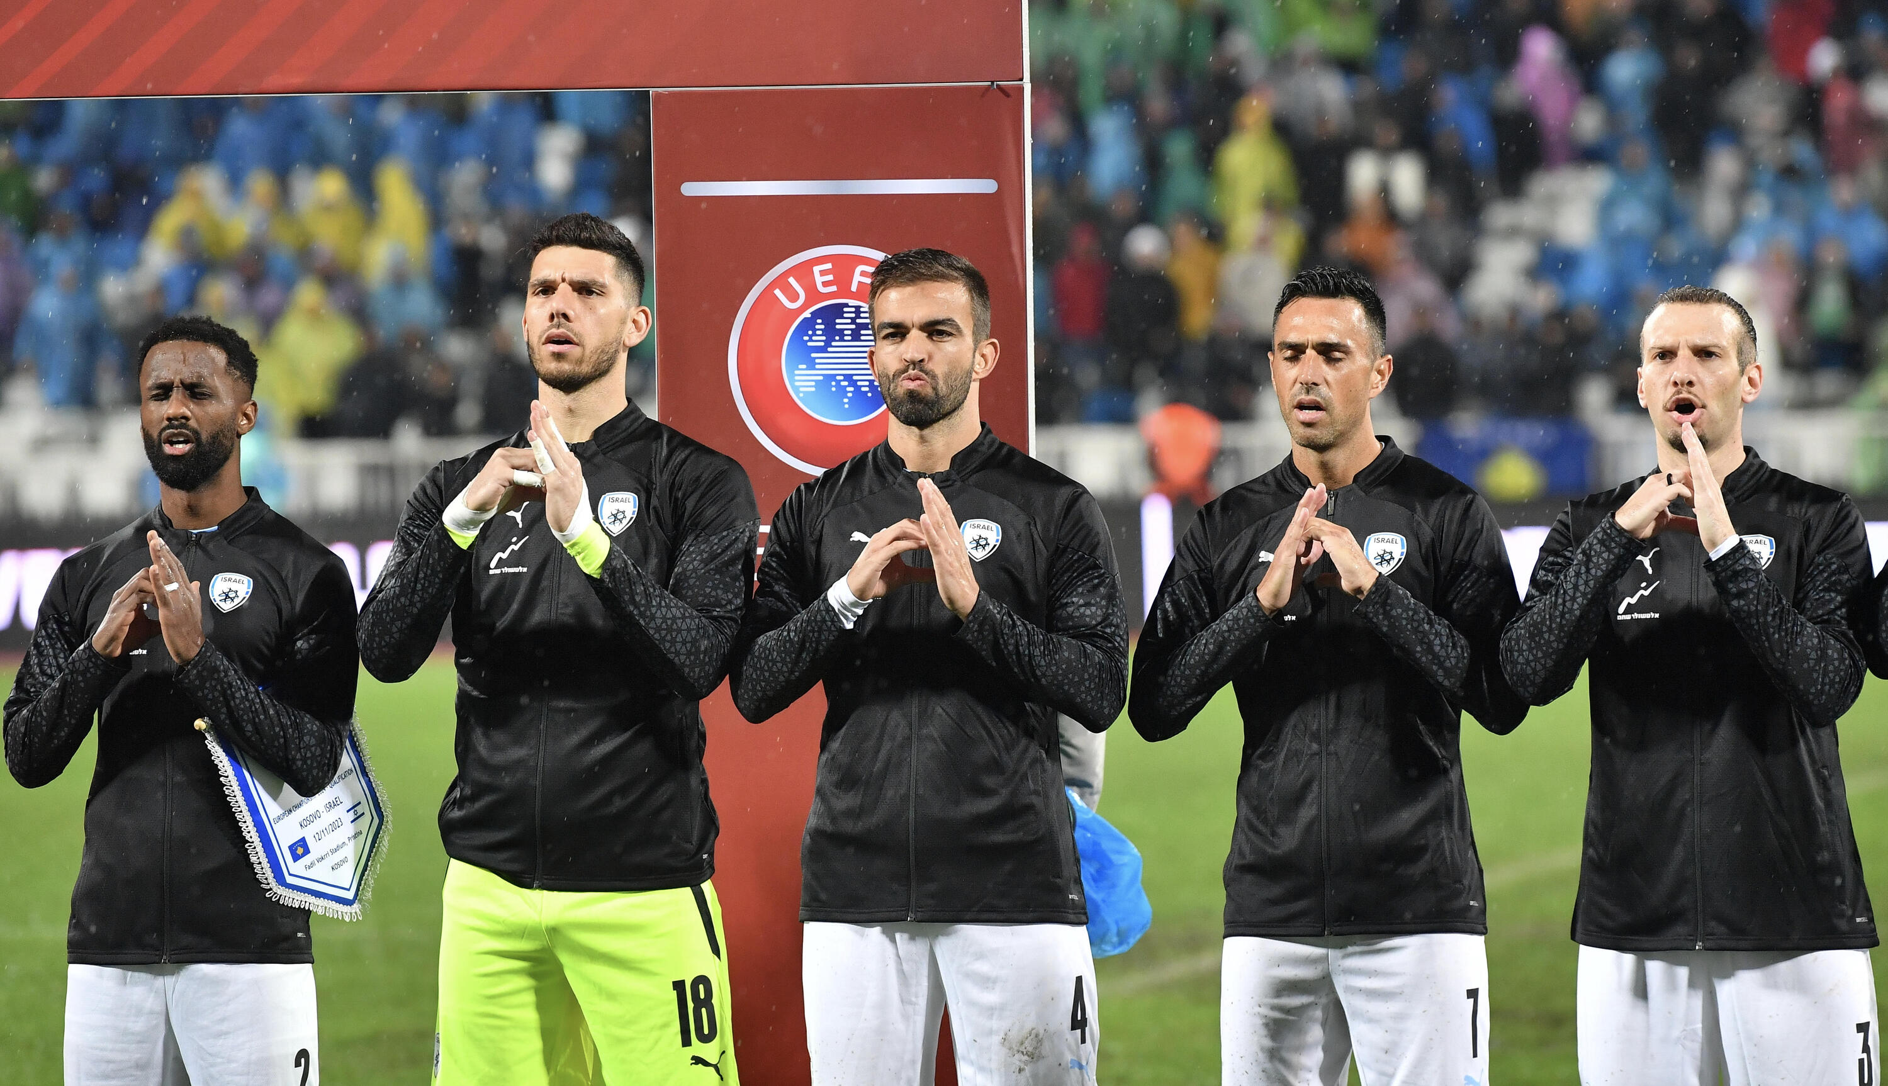
Once again, the Israel national football team failed to qualify for a major international tournament.
World Cup 1994
Euro 1996
World Cup 1998
Euro 2000
World Cup 2002
Euro 2004
World Cup 2006
Euro 2008
World Cup 2010
Euro 2012
World Cup 2014
Euro 2016
World Cup 2018
Euro 2020
World Cup 2022
Euro 2024
UEFA Nations League
Euro 2028
World Cup 2060
Euro 3000
World Cup …
Euro …

Slide 4
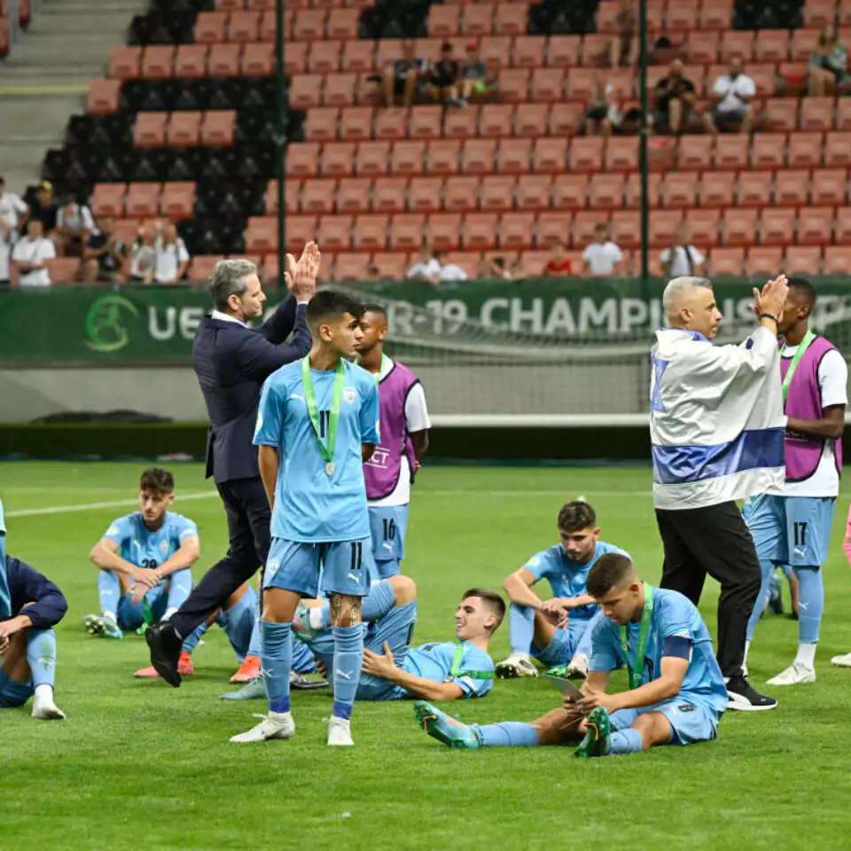
AND AGAIN

Slide 5

AND AGaIN

Slide 6

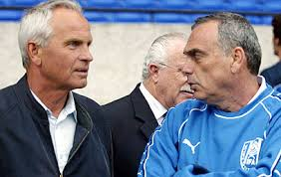
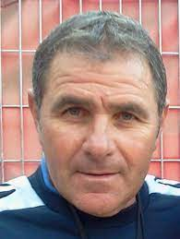

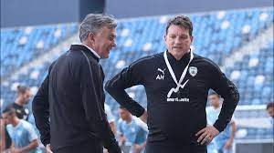
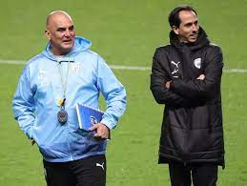
I decided to check who among the coaches was the most effective.
Israel joined UEFA in 1994, and since then, no coach has been able to lead our national team to the final stage of a major tournament.

Slide 7


Using the beautifulSoup function, I obtained information about all matches of the Israel national team from Wikipedia.

Slide 8
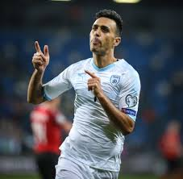
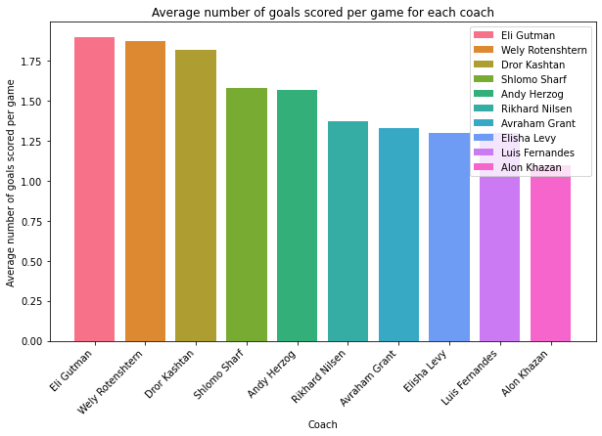
The coach under whom the national team scored the most goals.

Slide 9

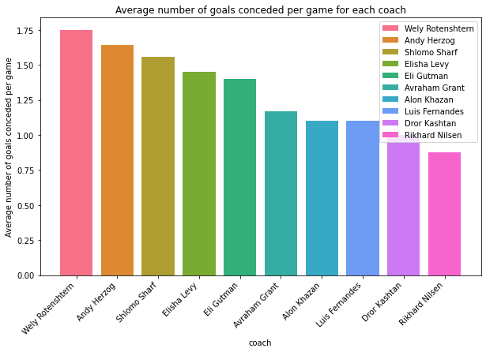
The coach under whom the national team conceded the most goals.

Slide 10

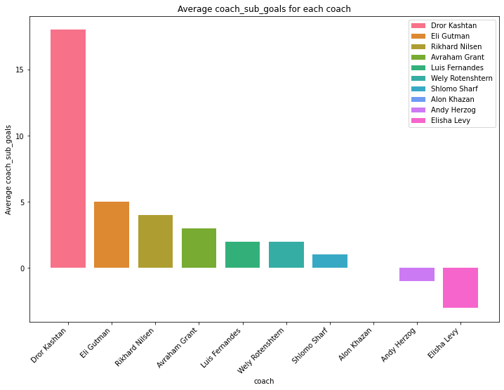
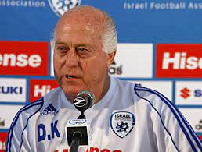
The best goal difference between scored and conceded goals.

Slide 11

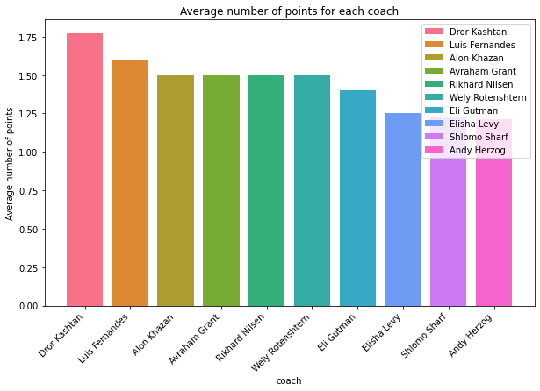
The coach under whom the national team averaged the most points per game

Slide 12
In memory of
Lior Asulin
Mai Na'im

